Slide 1
CTI League
Disinformation
2020-07-15
Introduction to Disinformation Tracking

Slide 2

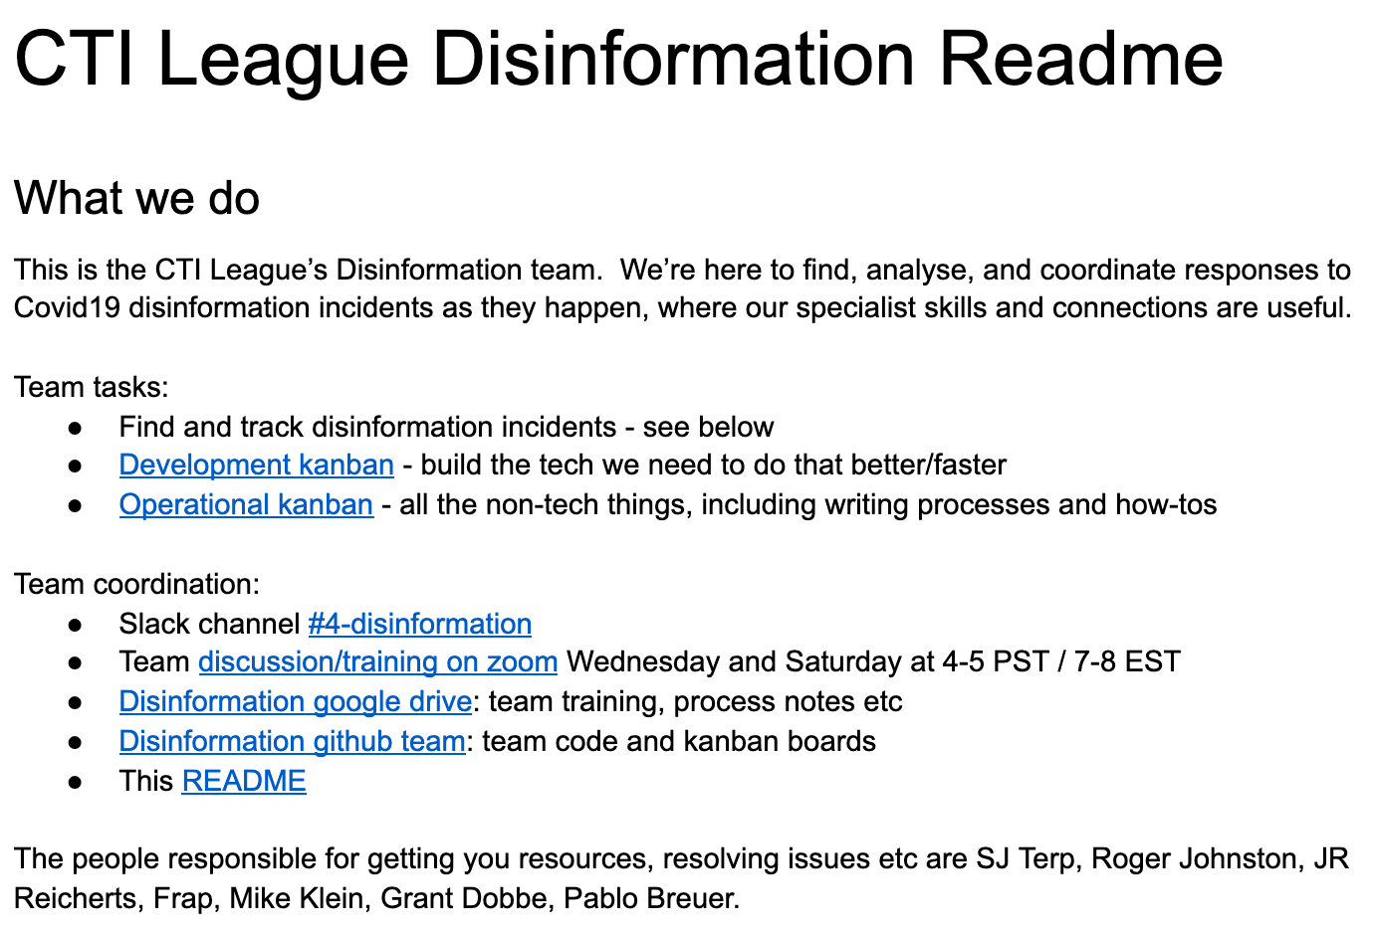
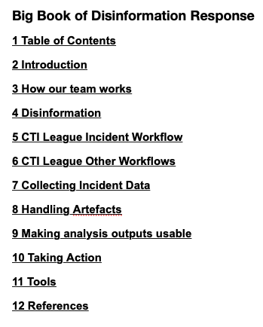
CTI League Disinformation Team
Notes:
Team readme: [Link Redacted]
BigBook: https://docs.google.com/document/d/1eeXoFtQpqthhVSBm91wer0uhS346lt3SEhU04ojQaPs/edit

Slide 3
CTI Disinfo Spaces
4-Disinfo
Open channel: A place for anyone in the league who wants to learn, engage, and share about Covid-related disinformation and disinformation techniques.
Also a place for anyone who wants to help with incident tasks (e.g. data gathering). Has access to open tools like MISP and the bots and read-only access to BigBook.
Disinfo-Triage
Vetted channel: A place to work on sensitive data and incidents.
Triage has access to the full CTI disinformation toolkit and write access to the BigBook.
You can join Triage by filling out the disinformation team survey, and saying that you’d like to join Triage.
Disinfo-Random
Open channel: Where you put anything that doesn’t fit into the other channels. Drop resources and observations in here and chat about disinfo.
It’s fine to discuss other types of disinformation and other areas affected beyond COVID, but please don’t run non-CTI incidents here.
Notes:
Examples of posts and where they should go
A fun post about disinformation in the gas industry = Random
Non-medical political disinformation = Random
Extremist disinformation = Random, unless they’re part of a disinfo incident
An alert about a (non-sensitive) potential new incident = 4-Disinfo
Articles on health-related disinfo = 4-Disinfo
Cool tools and ideas = 4-Disinfo (unless sensitive)
Announcements = 4-Disinfo
News from other groups = 4-Disinfo
“How’s everyone doing” check-ins = 4-Disinfo and Triage
An alert about a (sensitive) potential new incident = Triage
A post about a sensitive incident that we need to keep in triage = Triage
Our Channel Norms
Follow the League code of conduct https://cti-league.com/cti-league/code-of-conduct/
Don’t put disinformation into the disinformation channel without a warning that it is disinformation
Defang your urls (i.e., www[.]google[.]com)
Keep anything potentially triggering in threads
Incidents should be threaded, so please add posts related to incidents in the relevant thread
Content Warnings: Live by the rule of “First, do no harm”
You can use “CW” to indicate that there’s a content warning
Types of content that require content warnings: Violence, Hatred, self harm, etc.

Slide 4
Disinformation

Slide 5
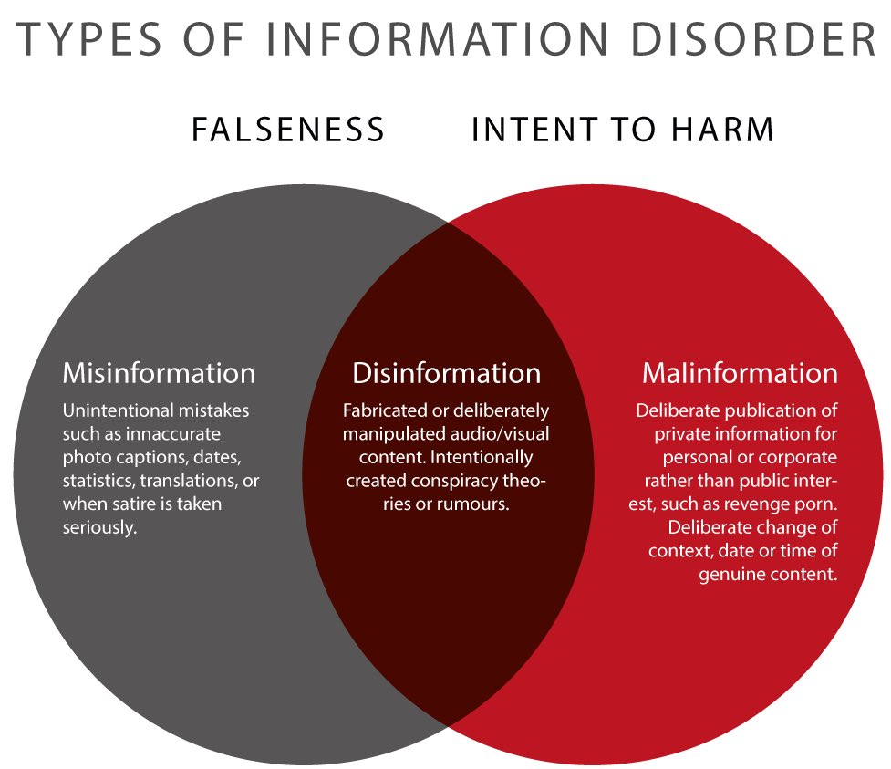
Disinformation - a working definition
“deliberate promotion… of false, misleading or mis-attributed information
focus on creation, propagation, consumption of disinformation online
We are especially interested in disinformation designed to change beliefs in a large number of people”
Notes:
It’s false. It’s intentional. It’s at scale. And the falsehood might not be in the content - the content, or the original poster’s intentions, might be clean, but the reuse, or amplification etc might be designed to create harm. Alway look for the harms, and the motivations for those harms.
Quote is misinfosec; Image is from First Draft’s work on Information Disorder (Clare Wardle, 2017)

Slide 6
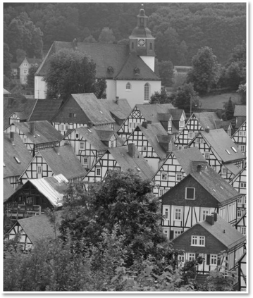
Geopolitically-motivated:
Westphalian Sovereignty
Each nation has sovereignty over its own territory and domestic affairs
Principal of non-interference in another country’s domestic affairs
Each state is equal under international law

Slide 7
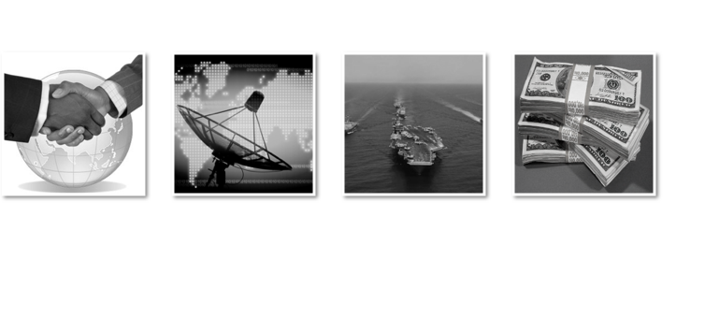
National instruments of Influence

Slide 8
Information threats to Countries
Democracy
Require common political knowledge
Who the rulers are
Legitimacy of the rulers
How government works
Draw on contested political knowledge to solve problems
Vulnerable to attacks on common political knowledge
Autocracy
Actively suppress common political knowledge
Benefit from contested political knowledge
Vulnerable to attacks on the monopoly of common political knowledge
Notes:
Democracy
Require common political knowledge
Who the rulers are
Legitimacy of the rulers
How government works
Draw on contested political knowledge to solve problems
Vulnerable to attacks on common political knowledge

Slide 9

Business instruments of Influence

Slide 10
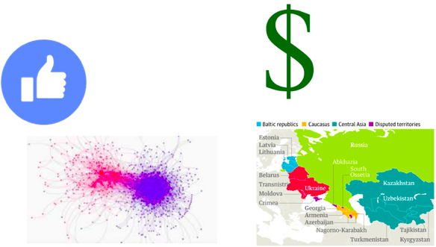
Where is disinformation coming from?
Geopolitical gain
Countries
Power gain
Follow the divisions
Financial gain
Follow the money
Attention seeking
Sharks, satire and other LOLs
Online discussion
opinion
conspiracies
protest
nazis
all the above
Blahblahblahblah
Notes:
“How to best determine between Fact (or fake fact) and opinion (which may be protected speech)”

Slide 11
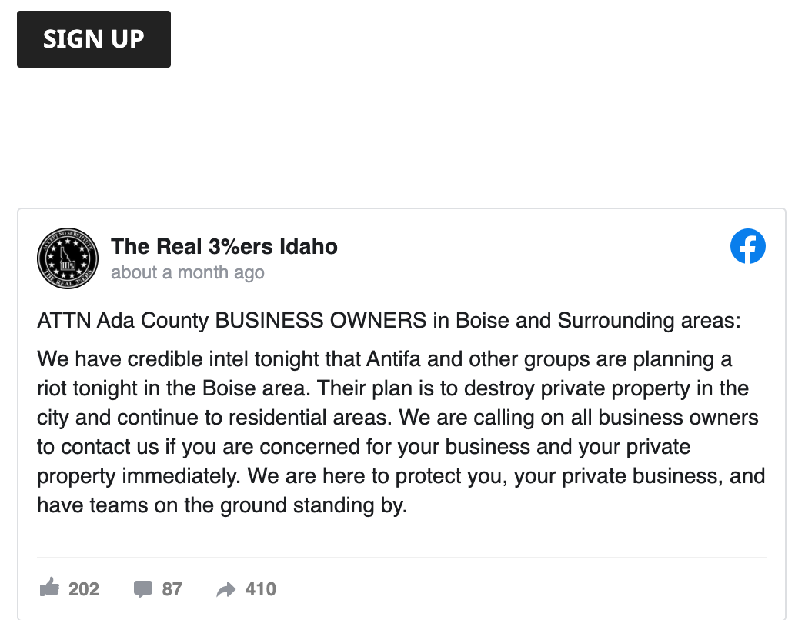
Power-motivated: Targeting and Harm

Slide 12
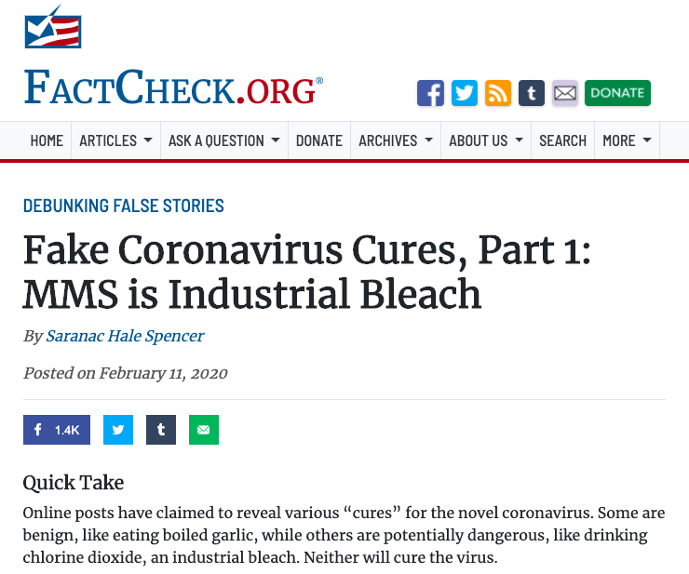
Financially-motivated
Covid19 hucksters are selling:
T-shirts
“Cures”
Blood
Views and clicks
And a bunch of other stuff
Follow the money!

Slide 13
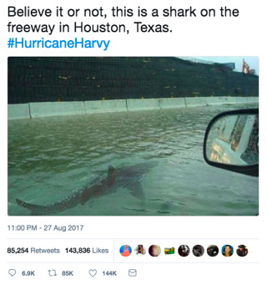
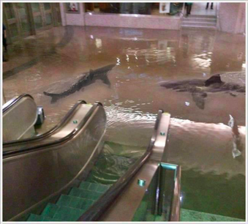
Doing it for the LOLs
Ignore, unless it’s DDOSing something we care about

Slide 14
Disinformation Incident Tracking and Response Process

Slide 15
DISINFORMATION LAYER MODELS
attacker
Campaigns
Incidents
Narratives
defender
Artifacts
Notes:
None of this works without good models of how to describe and share disinformation. This is what we see. Disinformation creators have longer-term campaigns (e.g. destabilise French politics). They create incidents (e.g. a short burst of messages around a specific topic or event), based on narratives, which are the stories that we tell ourselves about who we are, who we belong to, who we don’t belong to. Narratives are the level that most disinformation works at. But as responders, what we generally see are the artefacts: the messages, the images, the accounts, the relationships and groups. Misinfosec moved the conversation around disinformation from artefacts to incidents and narratives.

Slide 16
DISINFORMATION INCIDENT PROCESS
Alerting
Collection
Organisation and Analysis
Action
Humans
Groups
Feeds
DKAN
Incident data
Support data
HIVE
Incident tasks
& analysis
Slack
Reporting
Countering
Slack
Incident go/nogo
MISP
Incident objects
Cortex + Microservices
Data enrichment
Notes:
Running a large group also doesn’t work without processes. This is the current CTI stack - reusing threat intelligence tools for disinformation incidents, modifying them to fit.

Slide 17
Practical: deciding whether to start an incident
Is this potentially doing harm?
Is that intentional? (changes how you respond)
Are demographics etc being targeted?
Is this medically-related?
Is this part of something we’ve seen already (e.g. known medical scam types)
Is the content false, or is the falsehood elsewhere?
Fake groups, fake profiles, fake amplification etc
Is our team the best one to respond to this?
Is someone else already tracking and responding to this?
Is it e.g. phishing rather than disinformation?
Do we have the resources to respond?
Notes:
Satire and conspiracies - sometimes used as a gateway drug into more worrying groups.

Slide 18
DIGITAL HARMS
Physical harm | e.g. bodily injury, damage to physical assets (hardware, infrastructure, etc).
Psychological harm | e.g. depression, anxiety from cyber bullying, cyber stalking etc
Economic harm | financial loss, e.g. from data breach, cybercrime etc
Reputational harm | e.g. Organization: loss of consumers; Individual: disruption of personal life; Country: damaged trade negotiations.
Cultural harm | increase in social disruption, e.g. misinformation creating real-world violence.
Political harm | e.g. disruption in political process, government services from e.g. internet shutdown, botnets influencing votes
(List from https://dai-global-digital.com/cyber-harm.html)
Notes:
We’re looking for, and trying to reduce, harms. In this deployment, we’re specifically looking for medical harms. This is important because this year, social media companies, politicans etc shifted their definition of ‘bad’ from immediate calls for violence to the idea of digital harms where the effects might be delayed.

Slide 19
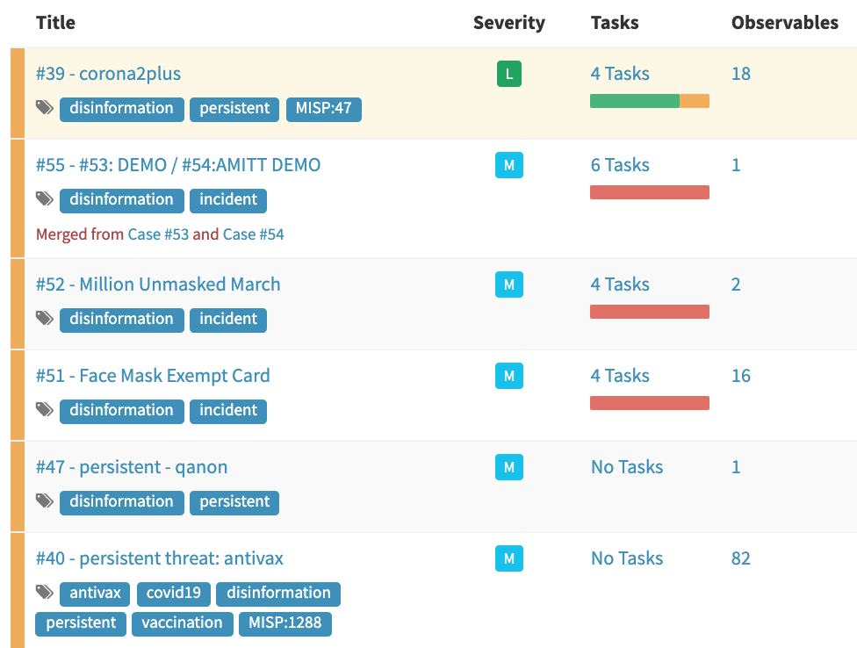
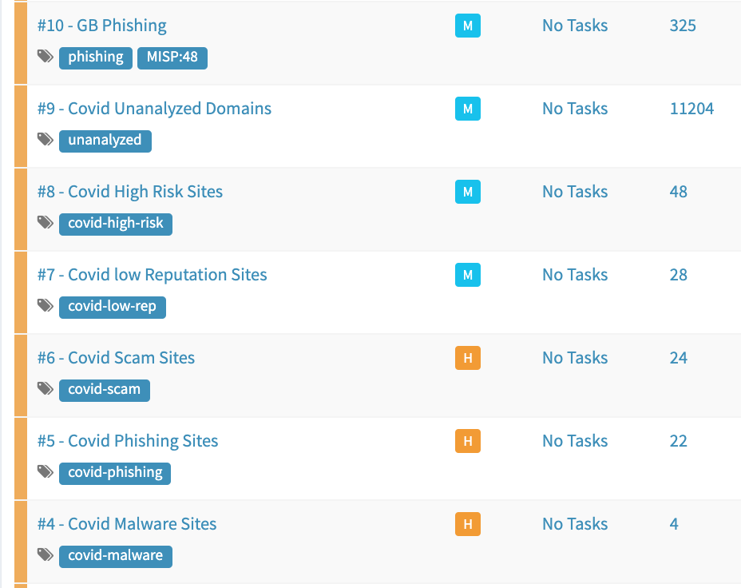
CASE/TASK MANAGEMENT (HIVE/D3PO/Cortex)
Notes:
CTI is tracking incidents using HIVE case tracking. It has a process for starting incidents that includes “is this relevant to Covid19, is it significant, are we the best team to do this, are there other teams likely to be working on this?” Cases also include persistent threats - groups, narratives, artefacts etc that are likely to appear in future incidents. [NB Observables in Hive are start observables only - most artefacts are stored in MISP or DKAN.]

Slide 20



MISP - Open Source Threat Intelligence Platform
De-facto standard for threat sharing
EU funded
ENISA, CIRCL
Open data standards
MISP Core, STIX
Large community
ISAC, ISAO, CERTs, CSIRTs
NATO, Military, Intelligence
Fortune 500’s
Notes:
MISP is an open source threat intel platform - originally a malware information sharing platform, we’ve repurposed it as a misinformation sharing platform.
MISP enables community driven, collaborative analysis and highly customizable sharing communities.
It’s a permanent fixture of the CTI community, including national CERTs and intelligence agencies, due it’s high security, extensibility, and vibrant community.
MISP can integrate with most CTI platforms via open data formats including STIX, CEF, and MISP, and provides easy methods of getting data in and out of the platform for non-technical consumers.
MISP is EU funded through ENISA and CIRCL.

Slide 21
Disinformation Objects: STIX Extension
Disinformation STIX | Description | Level | Infosec STIX
Report | communication to other responders | Communication | Report
Campaign | Longer attacks (Russia’s interference in the 2016 US elections is a “campaign”) | Strategy | Campaign
Incident | Shorter-duration attacks, often part of a campaign | Strategy | Intrusion Set
Course of Action | Response | Strategy | Course of Action
Identity | Actor (individual, group, organisation etc): creator, responder, target, useful idiot etc. | Strategy | Identity
Threat actor | Incident creator | Strategy | Threat Actor
Attack pattern | Technique used in incident (see framework for examples) | TTP | Attack pattern
Narrative | Malicious narrative (story, meme) | TTP | Malware
Tool | bot software, APIs, marketing tools | TTP | Tool
Observed Data | artefacts like messages, user accounts, etc | Artefact | Observed Data
Indicator | posting rates, follow rates etc | Artefact | Indicator
Vulnerability | Cognitive biases, community structural weakness etc | Vulnerability | Vulnerability
https://github.com/cogsec-collaborative/amitt_cti
Notes:
STIX is the sharing standard used by ISACs and ISAOs
We added two objects to STIX for disinformation: incident, and narrative. We didn’t need to change anything else.
This was the first step toward threat informed defence in the influence operation space.
Building STIX objects for disinformation enables us to model actors and their TTPs. STIX compliments MISP and ensures we’re able to transmit data across all threat intelligence platforms.

Slide 22
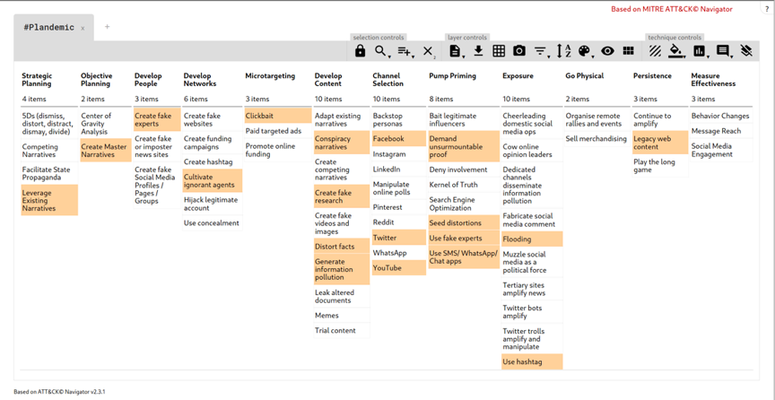
Disinformation TTPs: AMITT Framework
(TTP Framework adopted by MITRE, upstream development by CogSecCollab)
Notes:
This is the AMITT framework, used to describe and counter an incident.
It’s deliberately similar to the ATT&CK TTP framework
We’ve handed the AMITT Framework to MITRE to manage, whilst continuing to develop and use it.
In the AMITT framework repo, you can click on a technique and get details about what it is, who uses it, and which counters are available for it.
The AMITT framework was built to be practical. We need to be able to translate our findings into an actionable story.
The example here is Plandemic
Plandemic is a debunked conspiracy theory video which makes some false claims about the nature of COVID-19.
We can map out this small, but successful, operation in the AMITT framework to help us understand what capabilities the actor has and potentially how they’re resourced.
As with ATT&CK, we can use start building an understanding of actors capabilities over time.
These models are easily distributed within the community to our EU and NATO partners.

Slide 23
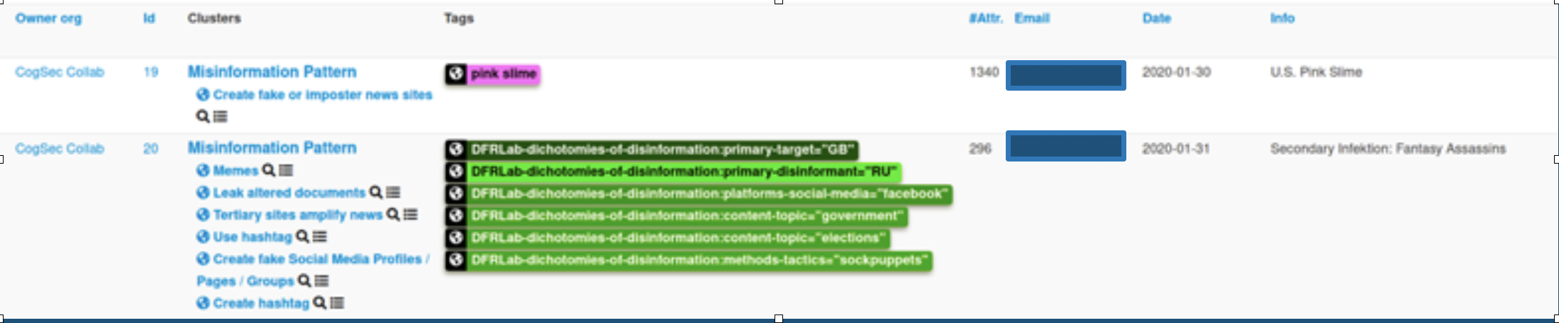
Disinformation Objects in MISP
DFRLab Dichotomies of Disinformation
NATO Disinformation Taxonomy (WIP)
MISP Objects
forged-document, publication, etc.
twitter-post, facebook-post, reddit-post, etc.
twitter-group, facebook-group, reddit-subreddit, etc
twitter-account, facebook-account, reddit-account, etc.
Notes:
MISP needed a new object set to cover disinformation and social media
The AMITT Framework ships with MISP, to cover disinformation TTPs.
We added other disinformation models to MISP as tags, including DFRlab’s dichotomies of disinformation taxonomy and the NATO Disinformation Taxonomy (a cutdown version of the DFRlab model, for sharing tactical information).
We’ve also added several new MISP objects to store social media data for Facebook, Twitter, Reddit, YouTube, Parler, as well as generic objects such as blogs, microblogs, publications, and new-media.
Here is an example of events tagged with both AM!TT Galaxy and DFRLab tags.

Slide 24
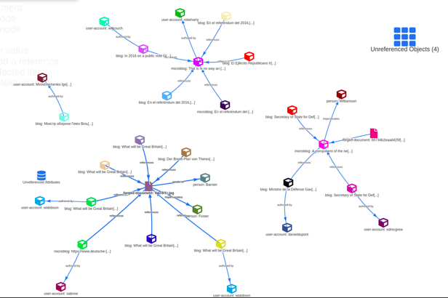
MISP Event Graphs
custom objects
forged-document
youtube-video
blog, etc.
custom relationships
authored-by
relates-to, etc.
Notes:
We need our data to tell a story. Using MISP objects we’re able to represent the relationships between things.
For example, who posted a blog post, who was mentioned in a news articles, who is the registered owner of a domain.
Ultimately these are the things we’re aiming to build and share. Not a flat list of indicators, but a model of how the adversary operates and how we can identify them moving forward.

Slide 25
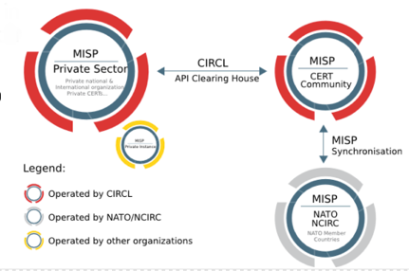
MISP Reporting and Data Exchange
API push/pull
Email
Optional GPG, S/MIME
JSON, MISP, STIX
XML, CEF, CSV, PDF
Anomali ThreatStream, ThreatConnect, OSQuery
Notes:
MISP provides several data export options.
The easiest option is an email notification, sent automatically to a list of people you want to update.
image: https://www.circl.lu/doc/misp/sharing/figures/MISP_scenario_example.png

Slide 26
Speeding it up: MISP Extensions and Integrations
Slack bots + Python script
one-liner saves 10+ minutes of analyst work per object
Facebook, Twitter, Reddit, YouTube, Parler, BuiltWith, etc.
Enrichment capabilities
MISP Modules
Cortex Analyzers
API driven
Notes:
We’ve built custom integrations to help analysts work with information operations in MISP.
Slack bots help our analysts get data into the platform faster.
A one line Slack command saves users 10 minutes of work each use.
The Slack bots use our open-source Python scripts to get data into MISP (using the MISP API) and we can similarly feeds MISP data from a CSV, other formats or even other platforms.
MISP includes data enrichment modules and can additionally integrate with third-party microservices such as Cortex.
Data enrichment on atomic artifacts such as DNS lookups, domain registrations, and usernames.
Export results via ZMQ to data lake or additional services.

Slide 27
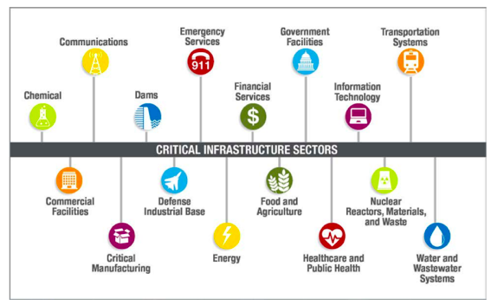
Response Actors
Platform
Law Enforcement
Government
Elves
Public
Influencer
Media
Nonprofit
Educator
Corporation
Notes:
Mostly, when people think about cognitive security, they look at platforms, public and government as responders. But as we catalogued counters, we found many types of people, resources and groups who could help, and work on how they could help.
One group CogSecCollab has supported is the information sharing and analysis organisations, the ISAOs and cyber Interpols. These already share infosec information for critical sectors in the USA, and we helped stand up (and suggested the name for) one that shares cognitive security information to all the other ISAOs and ISACs: the CS-ISAO (Cognitive Security ISAO).
CogSecCollab got interrupted by Covid19, but open-sourced our countermeasures lists. It has ideas...

Slide 28
TACTIC-BASED COUNTERMEASURES
AM!TT Phase | Deny | Disrupt | Degrade | Deceive | Destroy | Deter
Strategic Planning | 11 | 6 | 7 |  |  | 4
Objective Planning |  | 5
Develop People | 10 | 7 | 1 | 1 | 1 | 1
Develop Networks | 11 | 3 | 3 |  | 1
Microtargeting | 2 | 5
Develop Content | 13 | 8 | 5 | 2 |  | 5
Channel Selection | 7 | 7 | 3 | 1
Pump Priming | 7 | 3 | 2 |  |  | 3
Exposure | 3 | 14 | 2
Go Physical | 1 |  |  |  |  | 1
Persistence | 1 | 6 | 6
Measure Effectiveness |  | 1 | 2
Detect: find them
Deny: stop them getting in
Disrupt: interrupt them
Degrade: slow them down
Deceive: divert them
Destroy: damage them
Deter: discourage them
https://github.com/cogsec-collaborative/amitt_counters
Notes:
We took the list of potential responders, the AMITT tactics list, the JP-13 list of effects (Detect, Deny etc), and a roomful of experts, and built a disinformation courses of action matrix. Those JP-13 descriptions:
Detect: discover or discern the existence, presence, or fact of an intrusion into information systems. We included Detect because that’s what everyone was doing - looking, not reacting, and we wanted them to get that out of their systems.
Deny: prevent the adversary from accessing and using critical information, systems, and services.
Disrupt: break or interrupt the flow of information.
Degrade: reduce the effectiveness or efficiency of adversary command and control or communications systems, and information collection efforts or means.
Deceive: cause a person to believe what is not true. military deception seeks to mislead adversary decision makers by manipulating their perception of reality.
Destroy: damage a system or entity so badly that it cannot perform any function or be restored to a usable condition without being entirely rebuilt.
Deter: discourage. We added Deter to the list as a potentially useful category too.

Slide 29
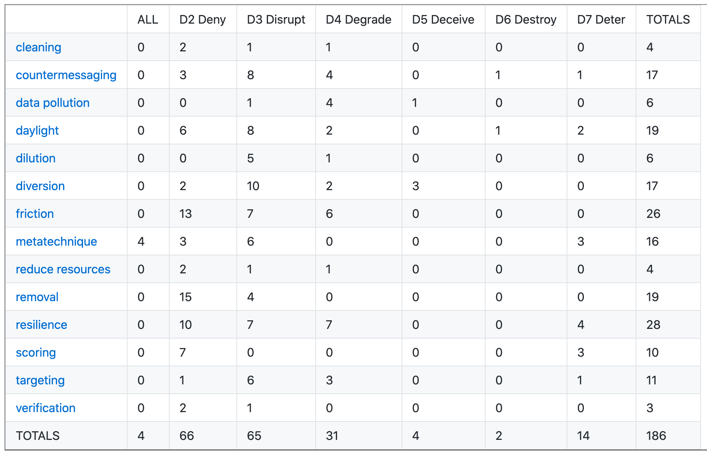
Effects-Based Countermeasures
Notes:
S: we’ve built out theory and examples for effects-based, tactic-based and doctrine-based countermeasures. For Covid19, we’re using effects-based only at the moment: reporting to law enforcement, reporting to platforms, registrars etc. We ran an exercise and cleanup that produced over 200 different ways to counter or mitigate disinformation incidents. The list items above are JP-13 response types, and a rough grouping of the types of response possible, used to organise that list of countermeasures. We’re pretty proud of moving the community past talking about looking at disinformation incidents and their only real responses being botnet takedowns and educating people, to seeing “TTP” in lots of groups’ slidesets.

Slide 30
Data Science for Disinformation Response

Slide 31
DS 4 Disinformation Response training series
2020-07-15 Introduction to the disinformation team
2020-05-06 What are we chasing? Digital harm training
TBA getting set up for disinformation data science
2020-05-27 Data sources (process, sources, stores)
2020-07-04 Disinfo Data Science examples
TBA Social text analysis
TBA Image data analysis
2020-07-11 Relationships as data
TBA Extending your analysis with machine learning skillz
TBA Communicating results (style, narratives, visualisations)
Notes:
AKA DS4DR

Slide 32
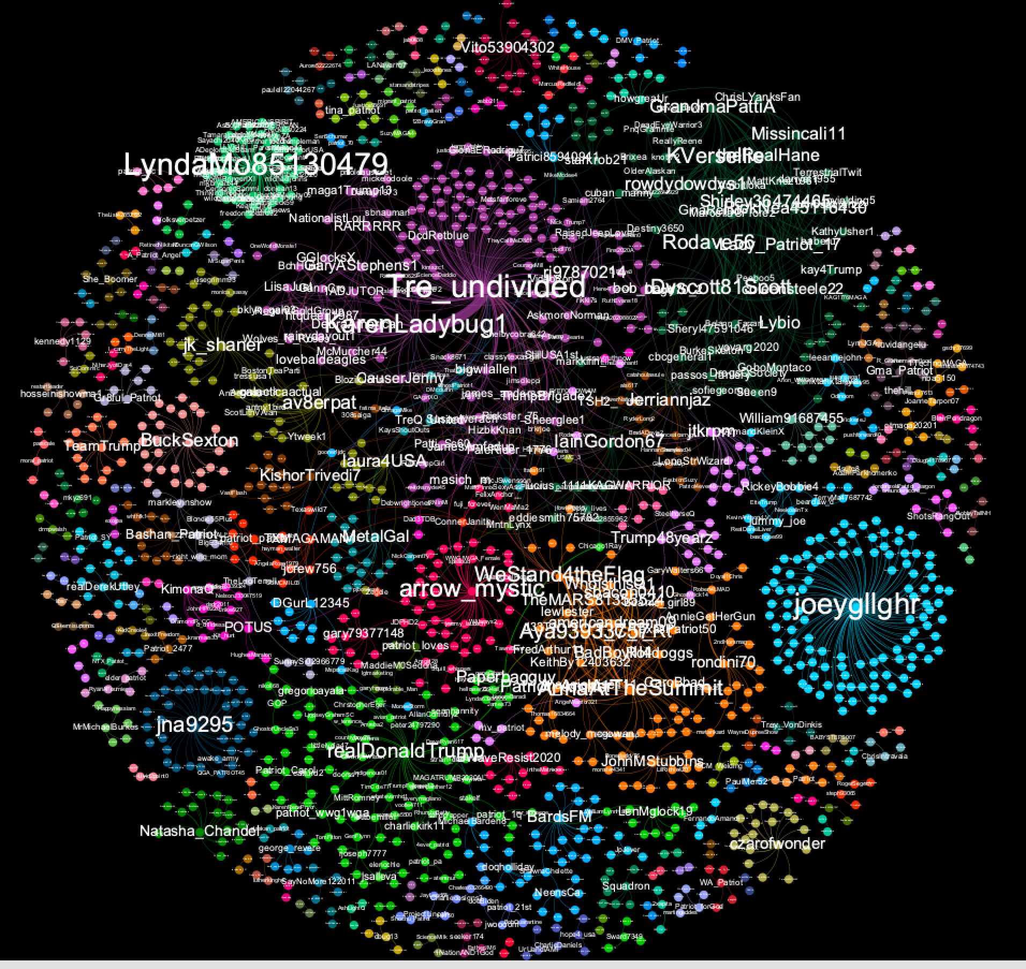
DATA SCIENCE FOR DISINFO RESPONSE: GRAPH ANALYSIS
Finding super-spreaders
Finding rumor origins
Finding new artefacts
Tracking movement over time
Notes:
Also happening now: a trial run of the “Data Science for Disinformation Response” university course, on the CTI League disinfo training schedule. Lots of work collecting up work done so far on this, creating processes and tools to meet new needs, and planning out the future. Most work at the moment is graph-based.

Slide 33
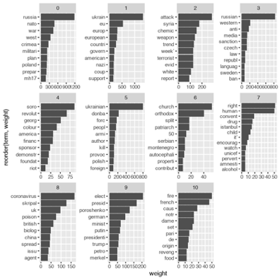
DS4DR: TEXT ANALYSIS
Finding themes
Classifying to narratives
Clustering
Searching for similar text/narratives
Notes:
The CogSecCollab has a datascience channel - it’s working on text-based algorithm needs.
[Image: term co-occurrence graph for text clusters in EuVsDisinfo. Yeah, we also scraped a bunch of data]

Slide 34
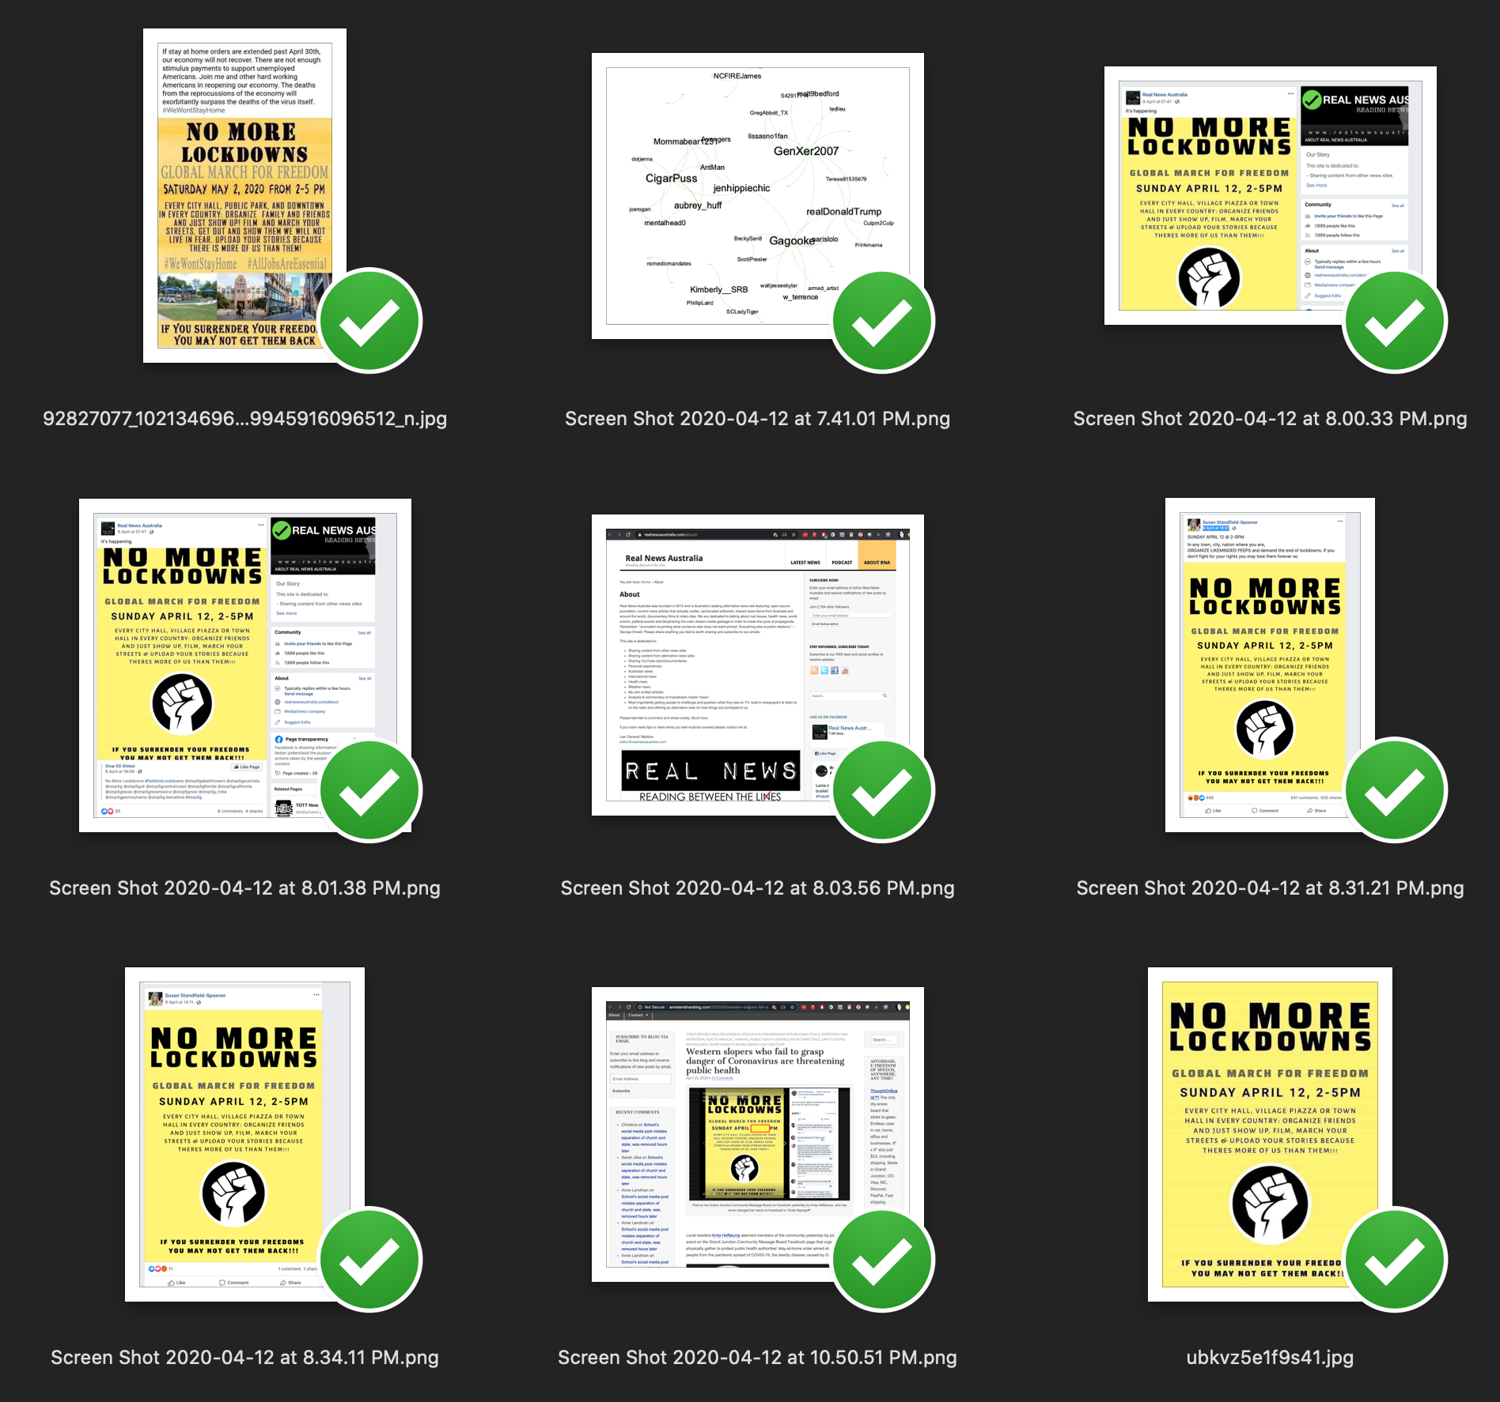
DS4DR: IMAGE, VIDEO , AUDIO ANALYSIS
Searching for similar images
Shallowfake detection
Notes:
Not much on image processing yet, but give it a week…
[Image: https://www.cnn.com/2019/05/23/politics/doctored-video-pelosi/index.html]

Slide 35
Example Responses

Slide 36
Covid19 Themes
Covid isn’t serious
Covid doesn’t exist
Individual medical targets
Medical scams
MMS prevents
Alcohol prevents
etc
Origin myths
Escaped bioweapon
Country x created Covid
US soldiers took Covid to China
Resolution myths
Country y has a Covid cure
Crossover with conspiracies
Covid and 5G
Covid and antivax / anti-Gates
Helicopters spraying for covid
Depopulation conspiracy
Crossover with ‘freedom rights’
Anti- stayathome
2nd amendment
anti-immigration
Usual far-rightwing groups
Geopolitics
China, Iran: covert + overt
“Blue check” disinfo
Notes:
Master narratives list:https://docs.google.com/spreadsheets/d/1yoiHNNSkNq5HoNEFiSrYTAE3nuFnp9wMBMcsh-TRx_w/edit#gid=398450894

Slide 37
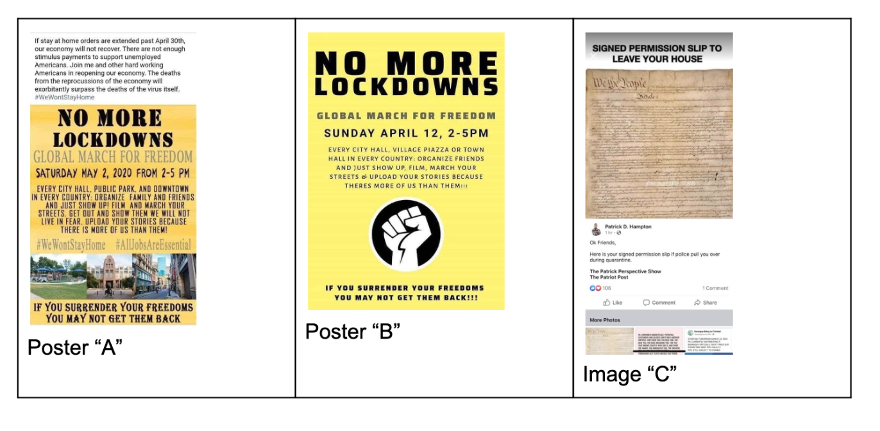
EXAMPLE RESPONSE: #WeWontStayHome
Notes:
And this is where we are now. We tracked WeWontStayHome because it was part of the health incident. It was a very small incident, but it seeded a much larger incident (operationGridlock) later. We also saw the incident spread across countries and states.
This is part of CTI’s history - we started with Googledocs and spreadsheets, and have been automating, scaling and speeding up from there.

Slide 38
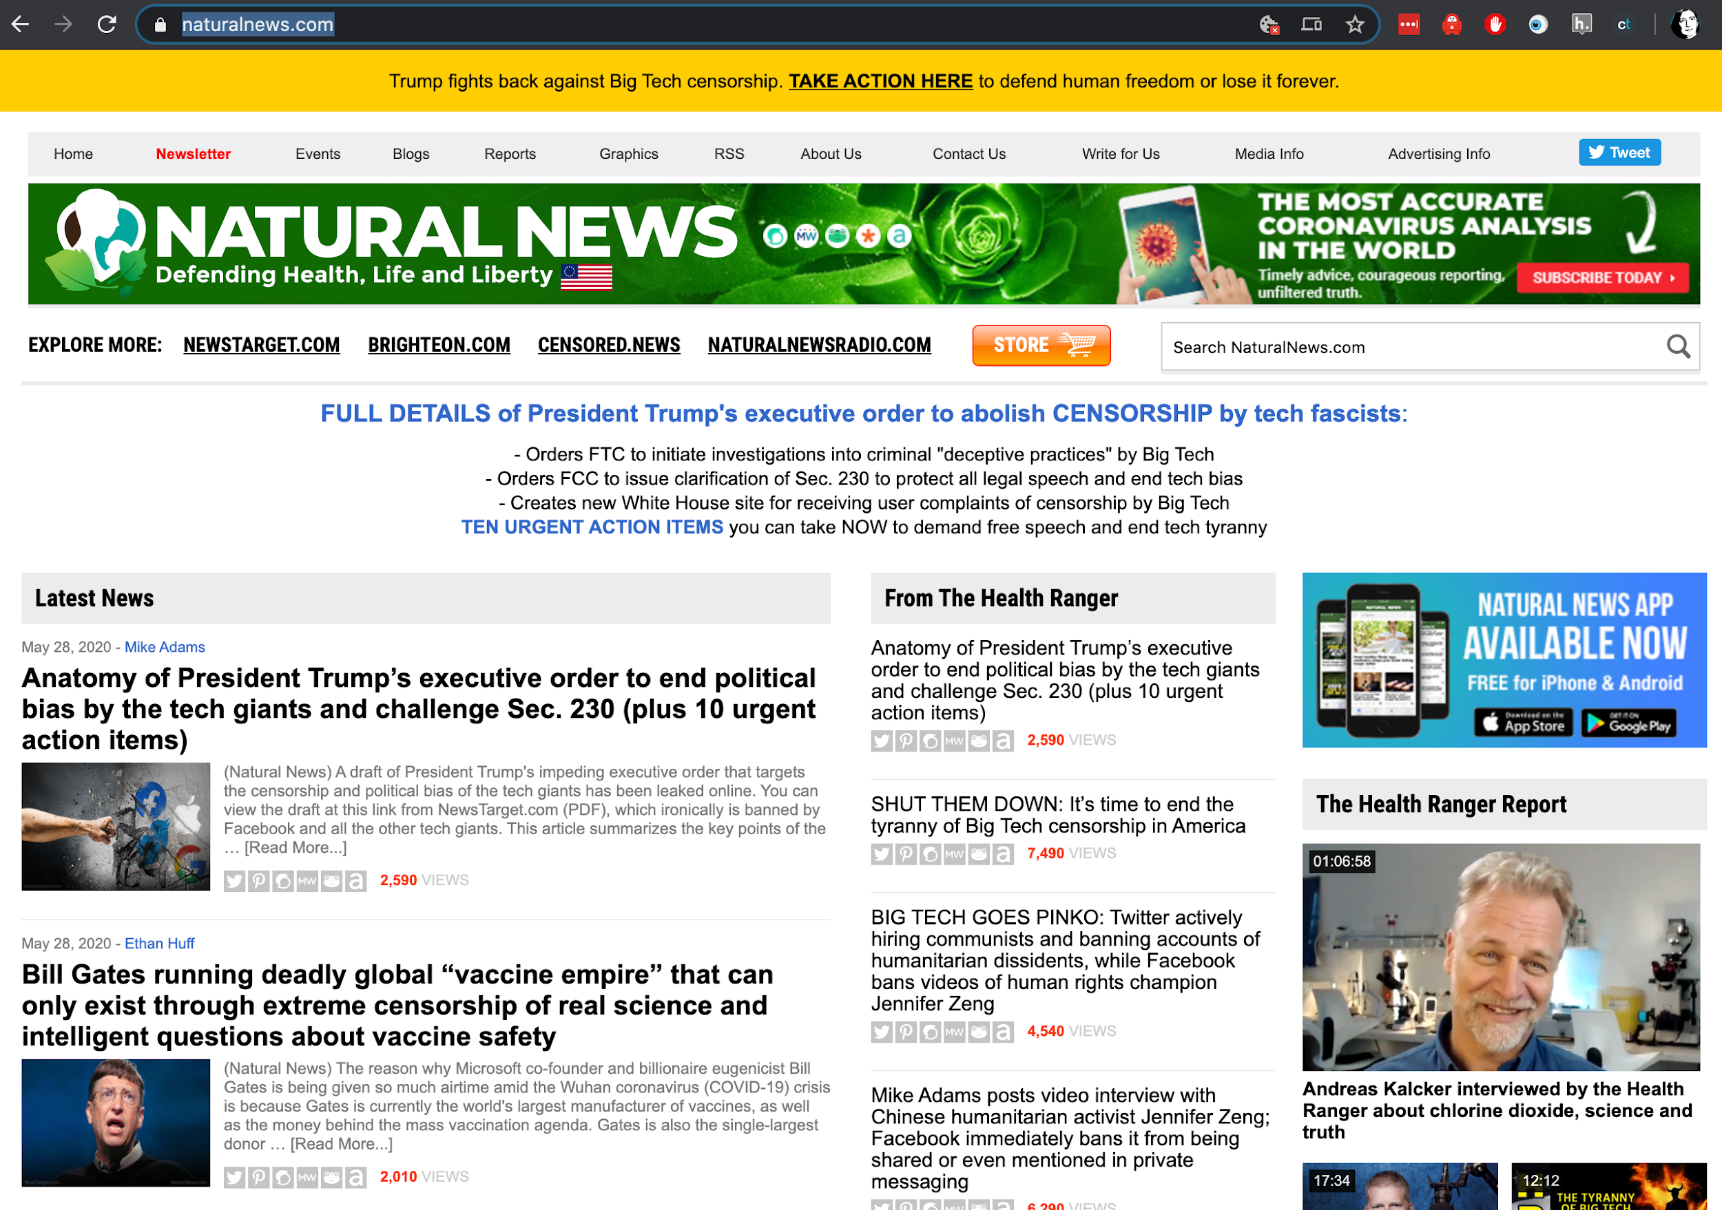
Example Response: Antivax Persistent Threat

Slide 39
Future Plans
Help healthcare orgs become more resilient to disinformation attacks
(and perhaps patients/citizens more resilient themselves)
Integrate Disinformation more into the rest of the league
Funnel into other workstreams and vice versa
Work together on hybrid campaigns

Slide 40
Over to You…

